Slide 1


Ibrahim Kobeissy
14-Feb-2022

Slide 2

Outline
Executive Summary
Introduction
Methodology
Results
Conclusion
Appendix

Slide 3
Executive Summary
Summary of methodologies
Data collection and Scraping
Data wrangling
EDA using visualization and SQL
Building an interactive map with Folium
Building a Dashboard with Plotly Dash
Predictive analysis (Classification)
Summary of all results
Exploratory data analysis results
Interactive analytics demo in screenshots
Predictive analysis results

Slide 4
Introduction
Project background and context
We will predict if the Falcon 9 first stage will land successfully.
SpaceX advertises Falcon 9 rocket launches on its website with a cost of 62 million dollars; other providers cost upward of 165 million dollars each, much of the savings is because SpaceX can reuse the first stage.
Problems you want to find answers
The key factor that determines if the rocket will land successfully
Therefore if we can determine if the first stage will land, we can determine the cost of a launch.
This information can be used if an alternate company wants to bid against SpaceX for a rocket launch

Slide 5


Slide 6
Methodology
Executive Summary
Data collection methodology:
SpaceX Rest API
Web Scrapping from Wikipedia
Perform data wrangling
Data encoding and removing irrelevant data
Perform exploratory data analysis (EDA) using visualization and SQL
Perform interactive visual analytics using Folium and Plotly Dash
Perform predictive analysis using classification models
How to build, tune, evaluate classification models

Slide 7
Data Collection
SpaceX REST API launch data,
This would give us information about the launches, rockets, payload, specifications and landing outcome
Falcon 9 Launch data from Wikipedia is web scrapped using BeautifulSoup.
SpaceX Rest API
Json Data
Normalize the data into CSV
Get HTML from Wikipedia
Extract data
using beautiful
soup
Normalize the data into CSV

Slide 8
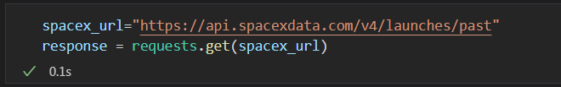
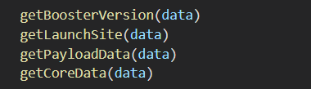
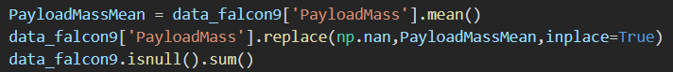
Data Collection – SpaceX API
Getting Response from API
Converting Response to a .json
Apply custom functions to clean data
Data cleanup
Filter and export to .csv
SpaceX API
Filter Falcon 9 Data only
Export to CSV
Data Wrangling
Github Notebook URL

Slide 9
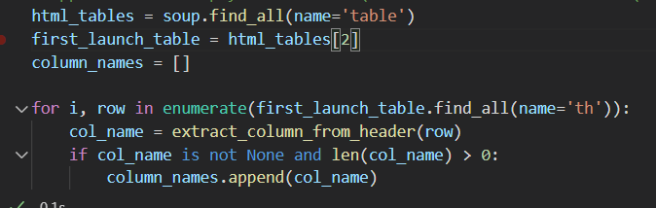
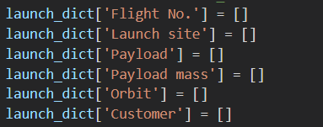
Data Collection - Scraping
Getting and parsing HTML
Filtering tables and columns
Dictionary creation
Export to CSV
Get HTML from Wikipedia
Export to CSV
Parse data
Extract data (beautiful soup)
Github Notebook URL

Slide 10
Data Wrangling
In the data set, there are several different cases where the booster did not land successfully.
Sometimes a landing was attempted but failed due to an accident; for example, “True Ocean” means the mission outcome was successfully landed to a specific region of the ocean while “False Ocean” means the mission outcome was unsuccessfully landed to a specific region of the Ocean.
We mainly convert those outcomes into Training Labels with 1 means the booster successfully landed 0 means it was unsuccessful.
Perform Exploratory Data Analysis EDA on dataset
Calculate the number of launches at each site
Calculate the number and occurrence of each orbit
Export dataset as
.CSV
Calculate the number and occurrence of mission outcome per orbit type
Create a landing outcome label from Outcome column
Github Notebook URL

Slide 11
EDA with Data Visualization
Scatter Chart
Flight Number VS. Payload Mass
Flight Number VS. Launch Site
Payload VS. Launch Site
Orbit VS. Flight Number
Payload VS. Orbit Type
Orbit VS. Payload Mass
Bar Chart
Success Rate of each orbit type
Line Chart
Launch success Yearly trend
Github Notebook URL

Slide 12
EDA with SQL
Display the names of the unique launch sites in the space mission
Display 5 records where launch sites begin with the string 'CCA’
Display the total payload mass carried by boosters launched by NASA (CRS)
Display average payload mass carried by booster version F9 v1.1
List the date when the first successful landing outcome in ground pad was acheived.
List the names of the boosters which have success in drone ship and have payload mass greater than 4000 but less than 6000
List the total number of successful and failure mission outcomes
List the names of the booster_versions which have carried the maximum payload mass. Use a subquery
List the failed landing_outcomes in drone ship, their booster versions, and launch site names for in year 2015
Rank the count of landing outcomes (such as Failure (drone ship) or Success (ground pad)) between the date 2010-06-04 and 2017-03-20, in descending order
Github Notebook URL

Slide 13
Build an Interactive Map with Folium
Summarize what map objects such as markers, circles, lines, etc. you created and added to a folium map
On the Folium map we added the following object
Map Marker, to create a marker on the map
Icon Marker, to add an icon on the map
Circle Marker, to add a highlighted circle area with a text label on a specific coordinate
Polyline, to create a line between points
Marker Cluster Object, to visualize multiple marker having the same coordinates

Slide 14
Build a Dashboard with Plotly Dash
Summarize what plots/graphs and interactions you have added to a dashboard
Explain why you added those plots and interactions
Add the GitHub URL of your completed Plotly Dash lab, as an external reference and peer-review purpose

Slide 15
Predictive Analysis (Classification)
Summarize how you built, evaluated, improved, and found the best performing classification model
You need present your model development process using key phrases and flowchart
Add the GitHub URL of your completed predictive analysis lab, as an external reference and peer-review purpose

Slide 16
Results
Exploratory data analysis results
Interactive analytics demo in screenshots
Predictive analysis results

Slide 17


Slide 18
Flight Number vs. Launch Site
Show a scatter plot of Flight Number vs. Launch Site
Show the screenshot of the scatter plot with explanations

Slide 19
Payload vs. Launch Site
Show a scatter plot of Payload vs. Launch Site
Show the screenshot of the scatter plot with explanations

Slide 20
Success Rate vs. Orbit Type
Show a bar chart for the success rate of each orbit type
Show the screenshot of the scatter plot with explanations

Slide 21
Flight Number vs. Orbit Type
Show a scatter point of Flight number vs. Orbit type
Show the screenshot of the scatter plot with explanations

Slide 22
Payload vs. Orbit Type
Show a scatter point of payload vs. orbit type
Show the screenshot of the scatter plot with explanations

Slide 23
Launch Success Yearly Trend
Show a line chart of yearly average success rate
Show the screenshot of the scatter plot with explanations

Slide 24
All Launch Site Names
Find the names of the unique launch sites
Present your query result with a short explanation here

Slide 25
Launch Site Names Begin with 'CCA'
Find 5 records where launch sites begin with `CCA`
Present your query result with a short explanation here

Slide 26
Total Payload Mass
Calculate the total payload carried by boosters from NASA
Present your query result with a short explanation here

Slide 27
Average Payload Mass by F9 v1.1
Calculate the average payload mass carried by booster version F9 v1.1
Present your query result with a short explanation here

Slide 28
First Successful Ground Landing Date
Find the dates of the first successful landing outcome on ground pad
Present your query result with a short explanation here

Slide 29
Successful Drone Ship Landing with Payload between 4000 and 6000
List the names of boosters which have successfully landed on drone ship and had payload mass greater than 4000 but less than 6000
Present your query result with a short explanation here

Slide 30
Total Number of Successful and Failure Mission Outcomes
Calculate the total number of successful and failure mission outcomes
Present your query result with a short explanation here

Slide 31
Boosters Carried Maximum Payload
List the names of the booster which have carried the maximum payload mass
Present your query result with a short explanation here

Slide 32
2015 Launch Records
List the failed landing_outcomes in drone ship, their booster versions, and launch site names for in year 2015
Present your query result with a short explanation here

Slide 33
Rank Landing Outcomes Between 2010-06-04 and 2017-03-20
Rank the count of landing outcomes (such as Failure (drone ship) or Success (ground pad)) between the date 2010-06-04 and 2017-03-20, in descending order
Present your query result with a short explanation here

Slide 34


Slide 35
<Folium Map Screenshot 1>
Replace <Folium map screenshot 1> title with an appropriate title
Explore the generated folium map and make a proper screenshot to include all launch sites’ location markers on a global map
Explain the important elements and findings on the screenshot

Slide 36
<Folium Map Screenshot 2>
Replace <Folium map screenshot 2> title with an appropriate title
Explore the folium map and make a proper screenshot to show the color-labeled launch outcomes on the map
Explain the important elements and findings on the screenshot

Slide 37
<Folium Map Screenshot 3>
Replace <Folium map screenshot 3> title with an appropriate title
Explore the generated folium map and show the screenshot of a selected launch site to its proximities such as railway, highway, coastline, with distance calculated and displayed
Explain the important elements and findings on the screenshot

Slide 38


Slide 39
<Dashboard Screenshot 1>
Replace <Dashboard screenshot 1> title with an appropriate title
Show the screenshot of launch success count for all sites, in a piechart
Explain the important elements and findings on the screenshot

Slide 40
<Dashboard Screenshot 2>
Replace <Dashboard screenshot 2> title with an appropriate title
Show the screenshot of the piechart for the launch site with highest launch success ratio
Explain the important elements and findings on the screenshot

Slide 41
<Dashboard Screenshot 3>
Replace <Dashboard screenshot 3> title with an appropriate title
Show screenshots of Payload vs. Launch Outcome scatter plot for all sites, with different payload selected in the range slider
Explain the important elements and findings on the screenshot, such as which payload range or booster version have the largest success rate, etc.

Slide 42


Slide 43
Classification Accuracy
Visualize the built model accuracy for all built classification models, in a bar chart
Find which model has the highest classification accuracy

Slide 44
Confusion Matrix
Show the confusion matrix of the best performing model with an explanation

Slide 45
Conclusions
Point 1
Point 2
Point 3
Point 4
…

Slide 46
Appendix
Include any relevant assets like Python code snippets, SQL queries, charts, Notebook outputs, or data sets that you may have created during this project

Slide 47


